Slide 1
Introduction to Web Technologies
Logic & Algorithms
Lecturer: Christen Cao

Slide 2
Summary
Logical operators &&, ||, !
Associativity, Distribution & DeMorgan Laws
Truth table
Operator precedence
Switch-case-default-break, statement
switch (x){
case x1: stmt0; break;
case x2: stmt1; break;
...
default: defaultStmt;
}
Examples

Slide 3
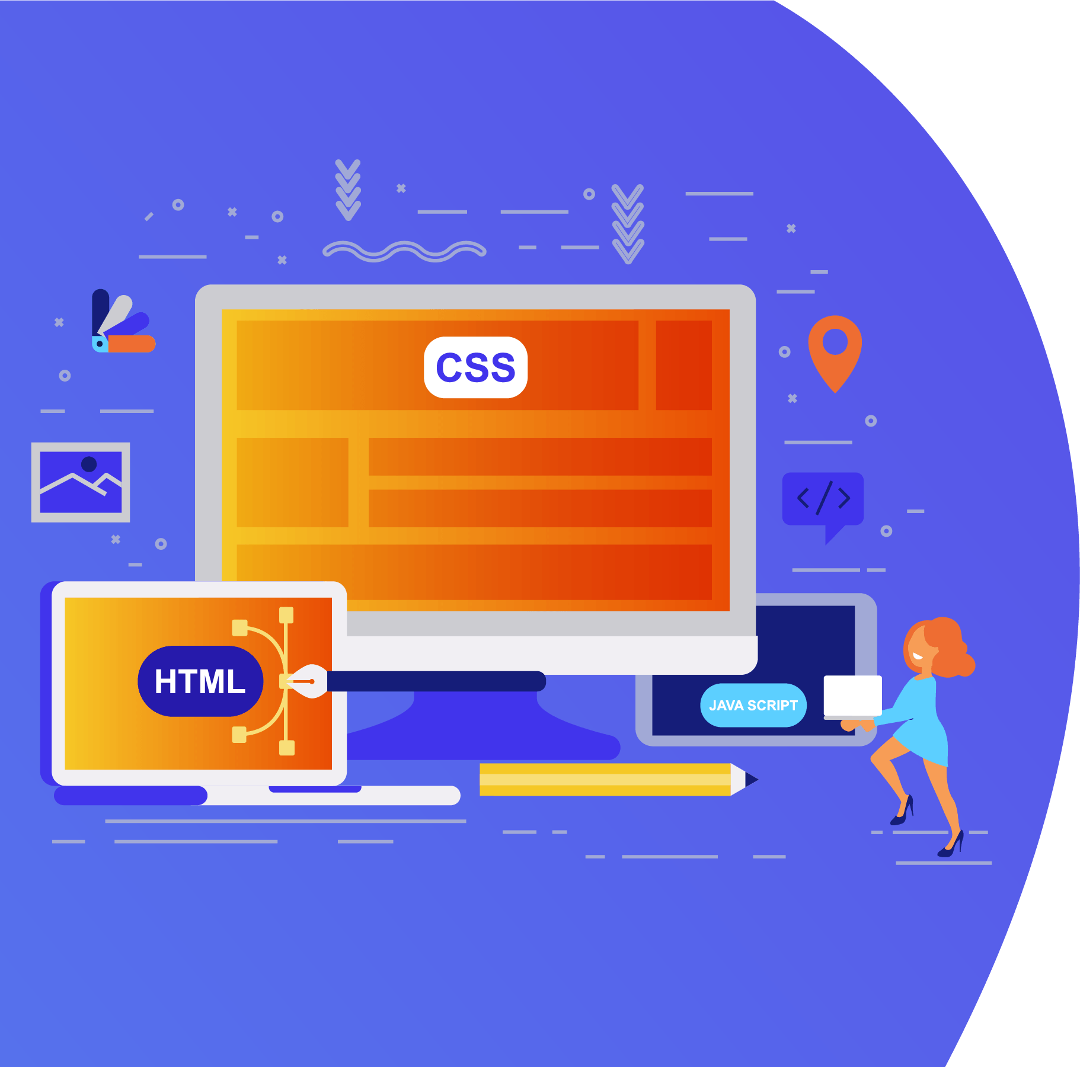
Topic 1: Logical Operators

Slide 4
Logical Operators
• and (&&), or(||) and not (!)
operands are logical values : true, false
can be used to make more advanced tests for use in
conditionals and iteration.
Enter a number, output message if it is between [2,4].
var x=Number(prompt("enter a number: "));
alert( x>=2 && x<=4 );
console.log(x<2 || x>4)

Slide 5
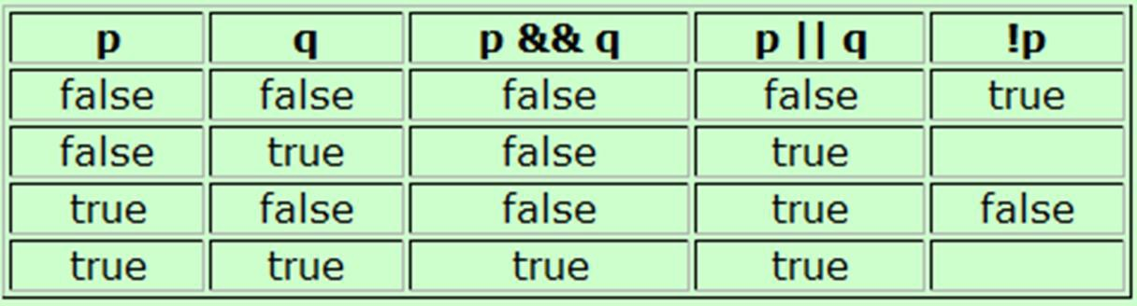
Truth Table
A chart showing the results of a logical operator for all
possible values of its operands.
p&&q is only true, if both its operands are true
p||q is true, if either of its operands are true
alert(true && false); alert(true || false);

Slide 6

Logical operator rules
Associativity:
– p&&q == q&&p,
– p||q == q||p
just as x*y =y*x ; x+y = y+x
Distribution
– p && ( q || r ) == (p&&q) || (p&&r)
Just as x*(y+z) = x*y + x*z
– p || ( q && r ) == (p||q) && (p||r)
DeMorgan special rules
– !(p&&q) == !p || !q
– !(p||q) == !p && !q

Slide 7
JS operator precedence
Highest priority first row, equal
precedence within a row:
. (record), [ ] (array)
--, ++ (de/increment, post/prefix)
! (not) +, - (unary, prefix)
• / ,*, %
• + , - (binary, infix)
• < ,<=, > ,>=
• ==, !=, ===, !==
• &&
• ||
• = (assign), +=, -= ,*= ,/= ,%=
c <= 'z' && ! b || c
c <= 'z' && (! b) || c
(c <= 'z') && (! b) || c
((c <= 'z') && (! b)) || c

Slide 8
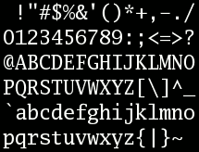
ASCII character
95 printable characters (codes 32 to 126)
start with "space" at 32
decimal digits 0-9 start at 48
26 upper case letters A-Z start at 65
26 lower case letters a-z start at 97

Slide 9
Try out: logical operators
Determine whether a character is lower case , letter, digit, vowel:
var c=prompt("enter a character:"); if( c>="a" && c<="z" )
alert("lower case letter");
if( c>="a" && c<="z" || c>="A" && c<="Z")
alert("letter");
if( "0"<=c && c<="9" )
alert("digit");
if( c=="a" || c=="e" || c=="i" || c=="o" || c=="u" ) alert("vowel");
4.1 - logical operators

Slide 10
Number systems
Decimal (base 10)
Ten fingers
Binary (base 2)
Fundamental number and logical system for computer
On and Off
Hexadecimal (base 16)
Binary numbers quickly become tedious to write.
Hexadecimal gives us a shorthand way to represent.

Slide 11
Decimal
Base: 10
• Digits: 0, 1, 2, 3, 4, 5, 6, 7, 8, 9
– Each digit in a decimal number is multiplied by 10^{n-1} where n is the column number, counting from right to left
10² | 10¹ | 10⁰
2 | 9 | 3
(2 * 10²) + (9 * 10¹) + (3 * 10⁰)
= 200 + 90 + 3
= 293

Slide 12
Binary
Base: 2
Digits: 0, 1
Each digit in a binary number is multiplied by
2^{n-1} (n is the column number, counting from right to left)
₂7 | ₂6 | ₂5 | ₂4 | ₂3 | ₂2 | ₂1 | ₂0
128 | 64 | 32 | 16 | 8 | 4 | 2 | 1
1 | 0 | 1 | 0 | 0 | 0
(1*2⁵)+(1*2³)
= 1x32+ 1x8 = 40

Slide 13
Hexadecimal
Dec | Hex | Binary
0 | 0 | 0000
1 | 1 | 0001
2 | 2 | 0010
3 | 3 | 0011
4 | 4 | 0100
5 | 5 | 0101
6 | 6 | 0110
7 | 7 | 0111
8 | 8 | 1000
9 | 9 | 1001
10 | A | 1010
11 | B | 1011
12 | C | 1100
13 | D | 1101
14 | E | 1110
15 | F | 1111
Base: 16
Digits: 0 ~9, A, B,
C, D, E, F
16³ | 16² | 16¹ | 16⁰
4096 | 256 | 16 | 1

Slide 14
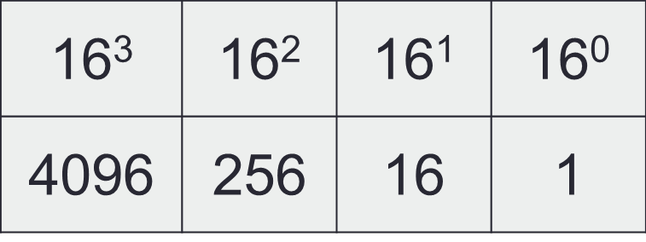
Exe: Convert Hex-number to decimal
The column headings are increasing powers of 16,
starting at 16⁰ on the right hand side.
A hexadecimal number: 2 3 E
The decimal equivalent :
(2x16²) + (3x16¹) + (14x16⁰) = 512 + 48 + 14 = 574
length−1

i =0
digVal *16
length−1−i
i
i index from left to right

Slide 15
Analysis steps
Step 1: Present in a genialised math formula,
derive roles from examples
length−1

i =0
digVal *16
length−1−i
i
i index from left to right
Step 2: get each elements, e.g. digVal
Step 3: consider functions, data structure, flow control in coding, e.g. sum, loop, power of Math obj.
Step 4: debug, pay attention to details and
possible errors, e.g. invalid inputs

Slide 16
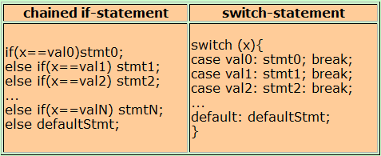
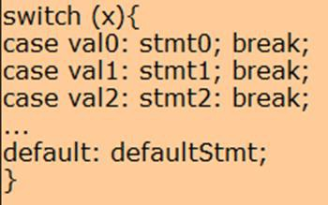
get digVal: Switch statement
switch-statement does not let you do anything that you could not do before
Stmt can be compound statements in {..;..;}.
break statement immediately terminates the compound statement in which it lies
4.2 - switch-statement, break-statement

Slide 17
Convert hex-digit to decimal (digVal)
var hex= prompt("Enter a hex-digit:");
var digVal;
switch(hex) {
case '0': digVal = 0; break;
case '1': digVal = 1; break;
….
case '9': digVal = 9; break;
case 'A': digVal = 10; break;
case 'B': digVal = 11; break; case 'C': digVal = 12; break; case 'D': digVal = 13; break; case 'E': digVal = 14; break; case 'F': digVal = 15; break;
default: digVal = "invalid Hex-digit";
}
alert('The decimal for the hex-digit is: ' + digVal);

Slide 18
Convert hex-digit to decimal (digVal)
var hex = prompt("enter a hexadecimal digit").toUpperCase(); var digVal;
switch(hex) {
case '0':
case '1’:
….
case '9': digVal = Number(hex); break;
case 'A': digVal = 10; break; case 'B': digVal = 11; break; case 'C': digVal = 12; break; case 'D': digVal = 13; break; case 'E': digVal = 14; break; case 'F': digVal = 15; break;
default: digVal = "invalid Hex-digit";
}
alert('The decimal number is: ' + digVal);

Slide 19
Convert Hex-number to decimal
var hexnum= prompt(“Enter a hex-number: ").toUpperCase();
var digVal,Dvalue=0; for(i in hexnum) {
hex=hexnum.charAt(i);
switch(hex) {
case "0": case "1": case "2": case "3": case "4":
case "5": case "6": case "7": case "8": case '9': digVal = Number(hex); break; case 'A': digVal = 10; break;
case 'B': digVal = 11; break; case 'C': digVal = 12; break; case 'D': digVal = 13; break; case 'E': digVal = 14; break; case 'F': digVal = 15; break;
default: digVal = "invalid Hex-digit";
}
if(digVal!="invalid Hex-digit“ )
Dvalue=Dvalue+(digVal*Math.pow(16,(hexnum.length-1-i)));
else {Dvalue="invalid Hex-number"; break;}
}
alert("Hex ="+hexnum+" Decimal ="+Dvalue);

Slide 20

summary: Iteration & conditionals
Loop:
for
do … while
while …
Array
Logical operators &&, ||, !
Lecture
Truth table
Operator precedence
switch (x){
case x1: stmt0; break;
...
default: defaultStmt;
}
Lab
Practice !
Logic thinking, math and algorithm

Slide 21
Content
Object, Function & expression
Conditionals & Relation
Number systems

Slide 22
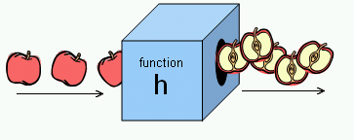
Functions and why?
identifier(parameter1, parameter2, …)
Function performs a specific task or procedure.
The task is to be carried out at multiple places for
multiple times
The task (procedure) is defined by experts and can be used by multiple people
Modularity: modular programming

Slide 23
Q&A: Object-oriented Programming (OOP)
Uses classes and objects to create models based
on the real world environment.
Easy to maintain and modify existing code as new objects are created inheriting characteristics from existing ones
Easy to understand the program after development with well designed classes, objects and their methods and properties.
Efficiency: add new or destroy unused objects/ classes easily

Slide 24
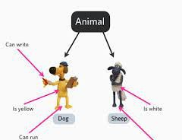
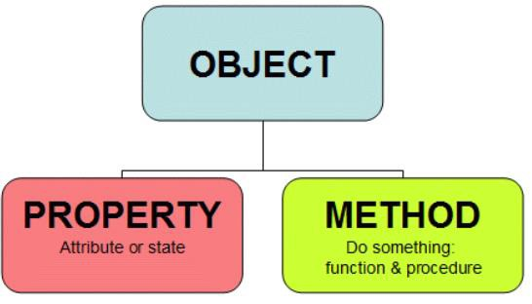
Q&A: Class/Object & JS
Class: a convenient way to abstract sets of objects with
common properties
"object" refers to a particular instance of a class
“object” can be containers of functions (methods), properties
(constants).
JS supports objects even without classes (OOP type)

Slide 25
Q&A: Procedure programming vs OOP
Procedure programming
Solving a problem from top of the code down to the
bottom
Statements start with strong verb
startCoffeeMachine(coffeemachineA);
washCoffeeMachine(coffeemachineB);
OOP
Solving a problem through objects
Statements start with the object to be manipulated
coffeemachineA.start(); coffeemachineB.wash();

Slide 26
Math.function( )
“Math” object: Container of math functions & constants.
Math.abs(x)
Math.sqrt(x)
Math.exp(x): E^{x}
Math.pow(x,n): x to the power n
Math.round(x), Math.ceil(x), Math.floor(x)
Math.max(...,...), Max.min(...,...)
Math.random() // [0,1)

Slide 27
Math.constant
Math.PI
returns PI, 3.14….
Math.SQRT2
returns 1.414…the square root of 2
Math.E
returns Euler's number 2.718…
It is just a value, so no brackets () are needed.

Slide 28
Expression
A legal combination of :
Value(s)
Variable(s)
Function call(s)
Operators
An expression represents a value
Used in a statement where a value is expected
Notes:
The values can be of various types, such as numbers and strings.

Slide 29
Expression Examples
For example, 5 * 10 evaluates to 50:
5*10 → 50
Expressions can also contain variable values:
var x;
x = 5;
x * 10 → 50
The values can be of various types, such as numbers and strings.
"John" + " " + "Doe” → "John Doe"
Notes:
→ : Evaluates to

Slide 30
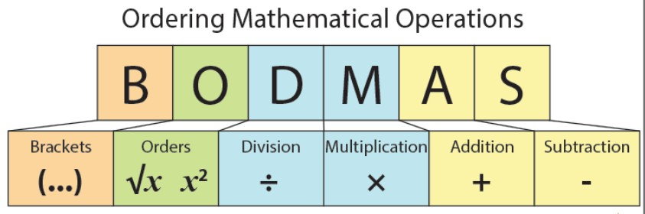
Evaluation sequencing
Nested functions: inner functions/brackets first
Follows the precedence of the operators BODMAS
Use () when not sure

Slide 31
Try out : how does it work ?
If we enter 5:
alert(3+2+prompt(“Enter a number"));
alert(3+(2+prompt(" Enter a number")));
alert(3+Number(2+prompt(" Enter a number")));
Enter 5: 55
Enter 5: 325
Enter 5: 28

Slide 32
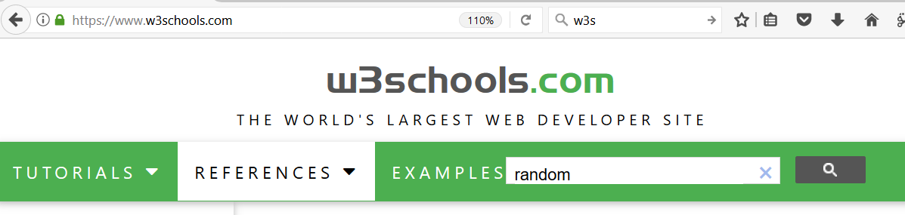
Try out:
Generate 8 random numbers between 0-10.
for(i=1; i<=8; i++) {
alert(Math.round(10*Math.random()));
}

Slide 33
Conditions

Slide 34


Conditions: if (…)…;
Decisive Programs: Branching / Selection
Begin Statement
if ( )
if true – S tatement
End Statement

Slide 35
Conditions: if (…) … else …;
Decisive Programs: Branching / Selection
Begin Statement
if ( )
else
if true - Statement
if false - Statement
End Statement

Slide 36
if (…) {… ;} else {…;}
if ( test ) { do-this-statement; }
if(x >0 ) {alert(“a positive number.”);}
Alternatives:
If ( test ) {do-this-statement;}
else {do-the-other-statement; }
var x=15;
if (x>0) {
alert(“a positive number.”);}
else {
alert(“it is <=0”);}

Slide 37
Relational operators
Finding relationships between values:
what is the opposite operator to “x<0” ?
== equal
!= unequal
< less than
<= less than or equal
> greater than
>= greater than or equal

Slide 38
Try out: Relational operators
== equal
=== strict equal
!= unequal
!== strict unequal
< less than
<= less than or equal
> greater than
>= greater than or equal
Compare numbers, characters, or
strings
ASCII (American Standard Code for Information Interchange) here
var x = 2; alert(x==2); alert(x>=0); alert(x!=2);
var x = 'a';
alert(x=='a');
alert(x>='b');
alert(x!='p');
alert('abc' == 'abc');
alert('abd' >= 'abc');
alert('aba' >= 'abc');
alert('abc' > 'ab');
alert(3 > 'abc');
Notes:
ASCII is pronounced as as-key.

Slide 39

Is a letter before or after “a” in Ascii?
var c=prompt("enter a letter:");
if(c<'a’) {
alert( c + " is before 'a' in Ascii"); }
Else {
alert( c + " is after 'a' in Ascii"); }
Ascii table: space … 0-9 …. A-Z
… a-z

Slide 40
Anything wrong?
var name=prompt("enter your name: ");
if(name="Mike") {
alert("Hi Mike" ); }
Else {
alert("it is not Mike"); }

Slide 41
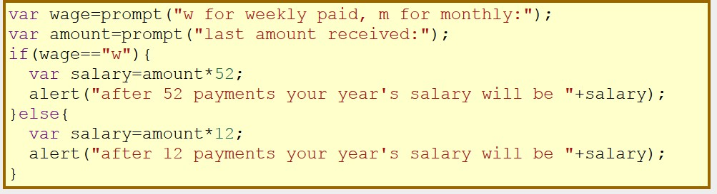
Compound Statements
if(...) {stmt1; stmt2; ...stmtn;}
if(...){...;...;} else {...;...;}
a sequence of single statements enclosed in curly braces
forms a compound statement.

Slide 42
Nested Conditionals
Begin Statement
if ( )
else
if ( )
else
if true - Statement
(nested) if true - Statement
Statement
End Statement

Slide 43
Nested Conditionals
Writing an if statement in another if statement is
called nesting.
• if(...){ if(...) ... } else { if(...) ... }

Slide 44
var x=15;
if (x<0) {
alert(" negative number"); }
else if (x>0) {
alert(“positive number"); }
else {
alert("it is 0 "); }
alert ("end");
Try out: Is x positive / negative?

Slide 45
var x=15;
if (x > 20) {
alert("x is bigger than 20"); }
else if (x > 10) {
alert(“x is bigger than 10 and less than 20"); }
else {
alert("x is equal to or smaller than 10"); }
alert ("end");
Try out: Is x bigger than 20?

Slide 46
Try: string functions
Strings are indexed from 0 !
A string of length n has characters indexed from 0
to n-1.
s.length
s.substr( start, length )
s.substring( from, upto ) // exclue the upto s.indexOf(subs), s.lastIndexOf(subs) s.indexOf(subs, from), s.lastIndexOf(subs, from) s.charAt() -> s.charAt(s.length-1) s.toUpperCase(), s.toLowerCase()
More info: JavaScript String Methods

Slide 47
Summary
Overview
Introduction to HTML
– Tags, attributes, class/ID selector,
CSS etc.
Introduction to JS
– Input/output, variables, arithmetic operators, math object, string functions
Conditionals
• if (...) … ; else ...;
Relational operators: ==, !=, >, >=,
<, <=
Lecture
Practice !

Slide 48
Programming for the World Wide Web
Number systems
Week 1

Slide 49
Number systems
Integer number
An integer (more commonly called an int) is a number without a decimal point
-2, 0, 500, 1024, etc.
Float number
A float is a floating-point number, which means it is a number that has a decimal place. Floats are used when more precision is needed
4.0, 3.1415, 0.000001, etc.

Slide 50
alert(…): single or double quotes ?
Output:
She says: “Hello!”
alert(‘She says "Hello" '); alert(“She says: 'Hello' ");
Escape character \'quote\' alert("Say \" Hello \" ");
alert('Say \'Hello\' ');
Which way is easy, popular or powerful !
JSON only allows double quotes.
Notes:
JSON (JavaScript Object Notation) is a lightweight data-interchange format.
it uses human-readable text to store and transmit data objects consisting of attribute–value pairs and arrays.
It is a common data format with diverse uses in electronic data interchange, including that of web applications with servers.

Slide 51
Anything wrong ?
var x=2;
if(x==2)
{ alert("it is 2 " )} ;
else
alert("it is not 2");
{ alert("it is 2 " ) ;}
if(...) {stmt1; stmt2; ...stmtn;} if(...){...;...;} else {...;...;}

Slide 52
Alignment, indentation, paired brackets …
if(0) alert('a'); else{ if(0) alert('b'); else alert('c') } How to make it easy to read and check?
if(0) {
alert('a’);
}
else{
if(0) {
alert('b’);
}
else {
alert('c’);
}
}
c

Slide 53
Are they equivalent? If not, which one is correct?
var x = 4;
if(x >= 0) {
if(x==0) {alert("x equals to 0");}
else {alert("x is greater than 0");
}
var x = 4;
if(x >= 0) {
if(x==0) {
alert("x equals 0");
}
else {
alert("x is greater than 0");
}
}

Slide 54
Are they equivalent? If not, which one is correct?
var x = -1;
if(x >= 0){
if(x==0)alert("x equals 0");
}
else alert("x is greater than 0");

